Slide 1
DevOps Tool

Slide 2
Source Code Management tools
Docker
Container Management Tool
Ansible

Slide 3
Software Configuration Management
Configuration Management (CM) is a systems engineering process for establishing and maintaining consistency of a product’s performance, functional, and physical attributes with its requirements, design, and operational information throughout its life.
Configuration management determines clearly about the items that make up the software or system. These items include source code, test scripts, third-party software, hardware, data and both development and test documentation
Notes:
Sources: http://toolsqa.com/software-testing/configuration-management/
https://git-scm.com/book/en/v2/Getting-Started-About-Version-Control
https://www.atlassian.com/git/tutorials/what-is-version-control

Slide 4
Software Configuration Management Tools
Subversion (SVN)
Team Foundation Server (TFS)
Git
Bitbucket
Mercurial

Slide 5
Git
Git is a distributed version control system designed to ensure speed, integrity and support for non-linear workflows.
It is used in both open source and commercial software development environments.
Git is one of the most popular methods in the world for tracking changes.
A key feature is that it enables developers to have independent branches, which turn enables, frictionless context switching, role-based codelines, feature-based workflows and disposable experimentation
Notes:
Having usurped previous version control systems such as CVS and Subversion, Git is now one of the most popular methods in the world for tracking changes.
A key feature is that it enables developers to have independent branches, which turn enables, frictionless context switching, role-based codelines, feature-based workflows and disposable experimentation. Ultimately, this enables more creativity, freedom and possibilities for developers when undertaking complex and challenging work.

Slide 6
Git

Slide 7
What is Git?
Git is an Open Source Distributed Version Control System
It is most Popular tool primary used for source code management in the software development
It can also be used to keep track of changes in any set of files
Git is created by Linus Torvald

Slide 8
What is a Git Repository?
A Git repository is a virtual storage of your project. It allows you to save versions of your code, which you can access when needed.

Slide 9
Types of Repository
Local Repository: repository which is created in local system
Remote Repository: repository which is present on remote location which is created with the help of github or gitlab etc.

Slide 10
Git Architecture
Working Directory
Git add
Staging Area
reset
Git Repository
commit

Slide 11
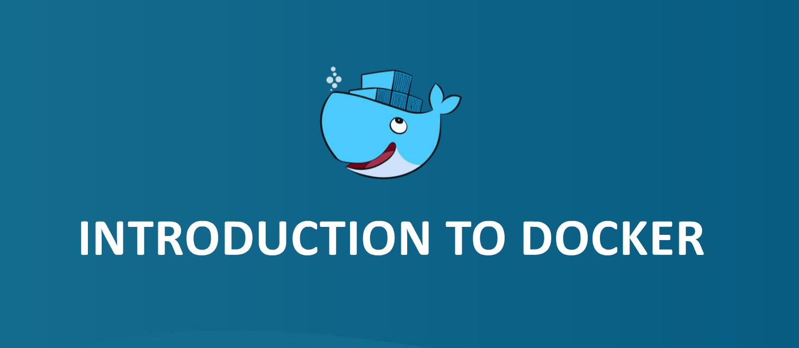

Slide 12


Slide 13
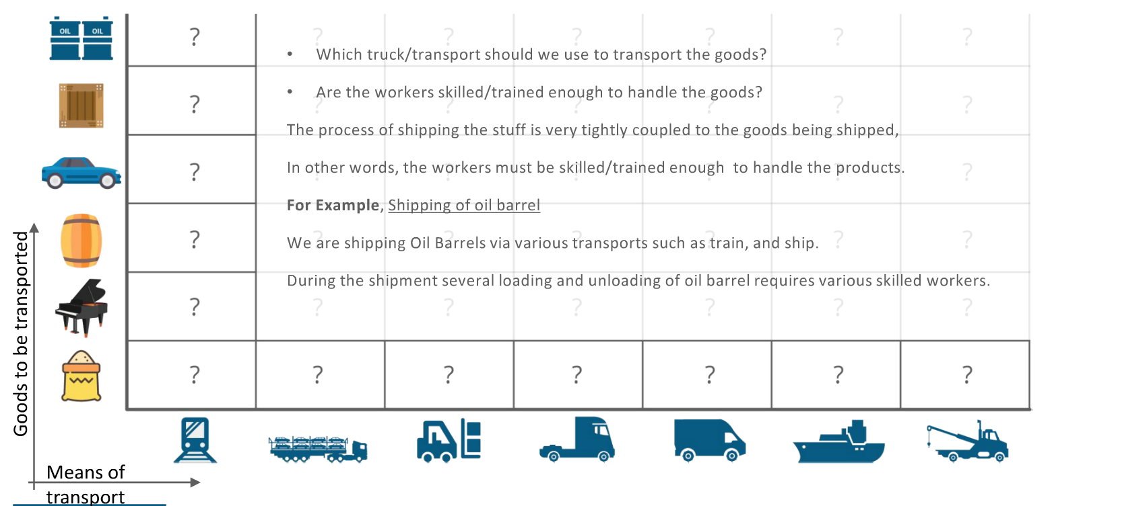

Slide 14
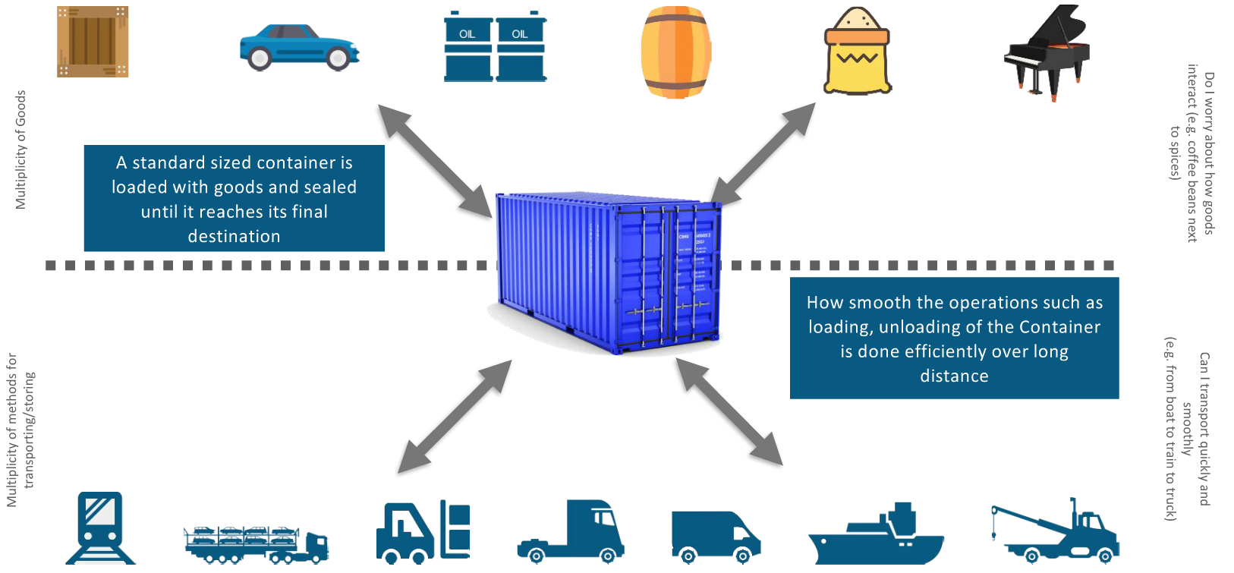

Slide 15
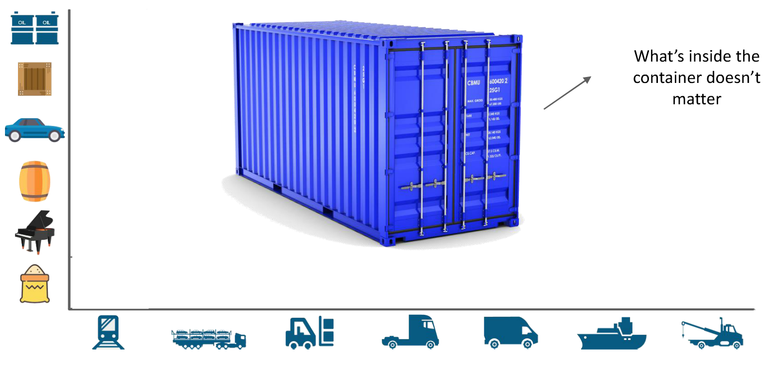

Slide 16
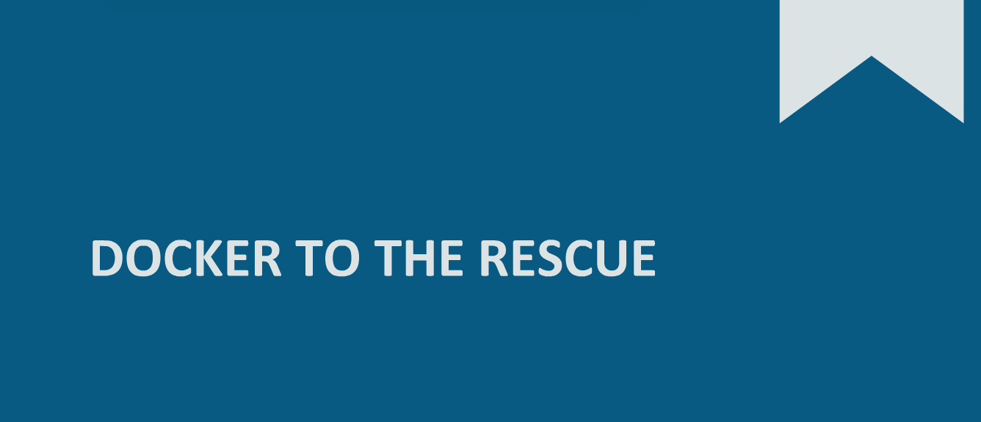

Slide 17
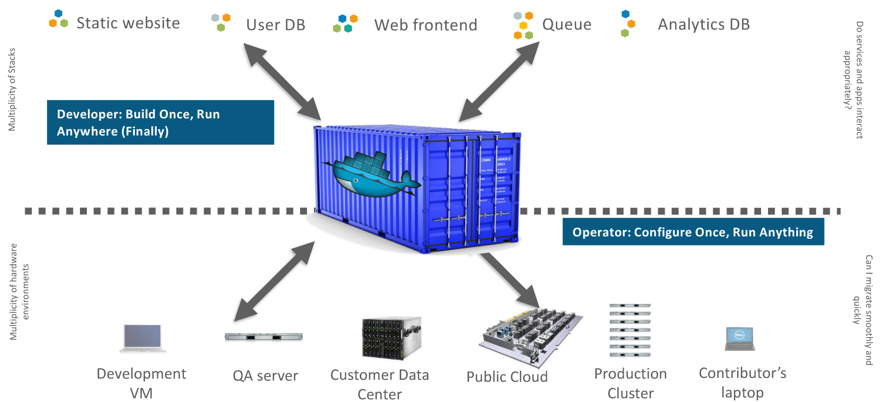

Slide 18
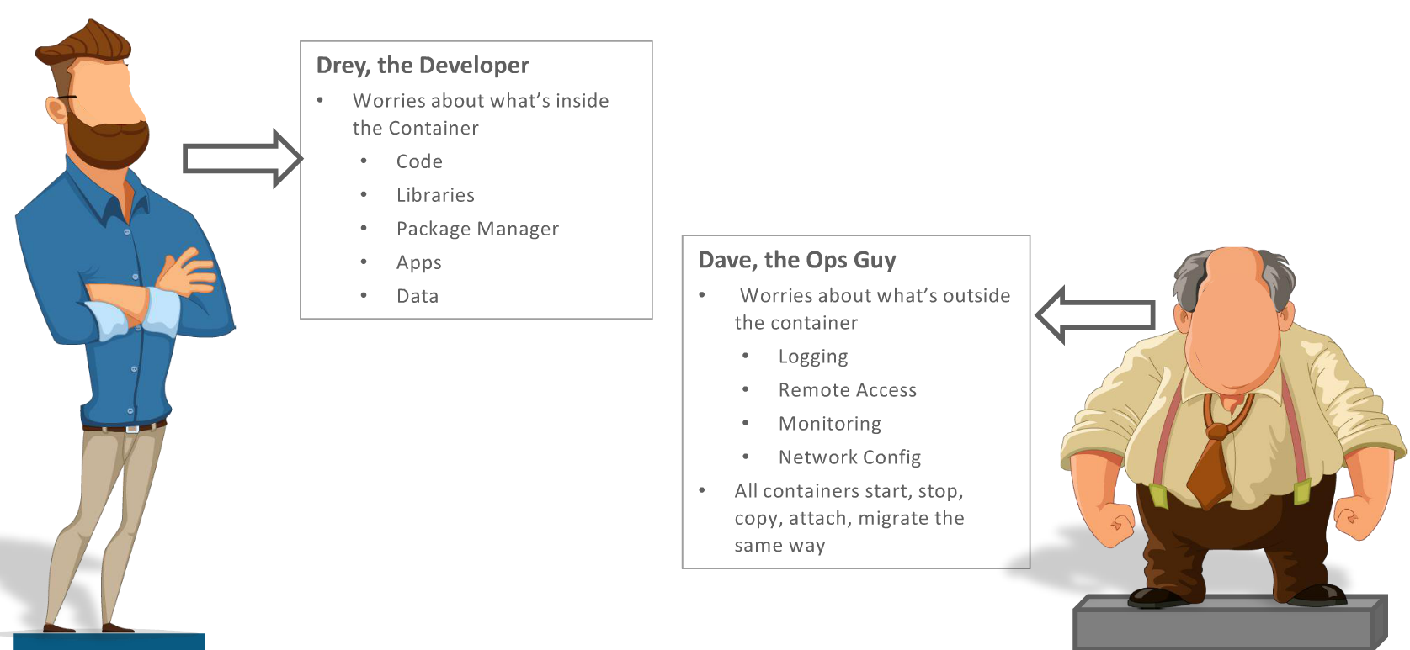

Slide 19
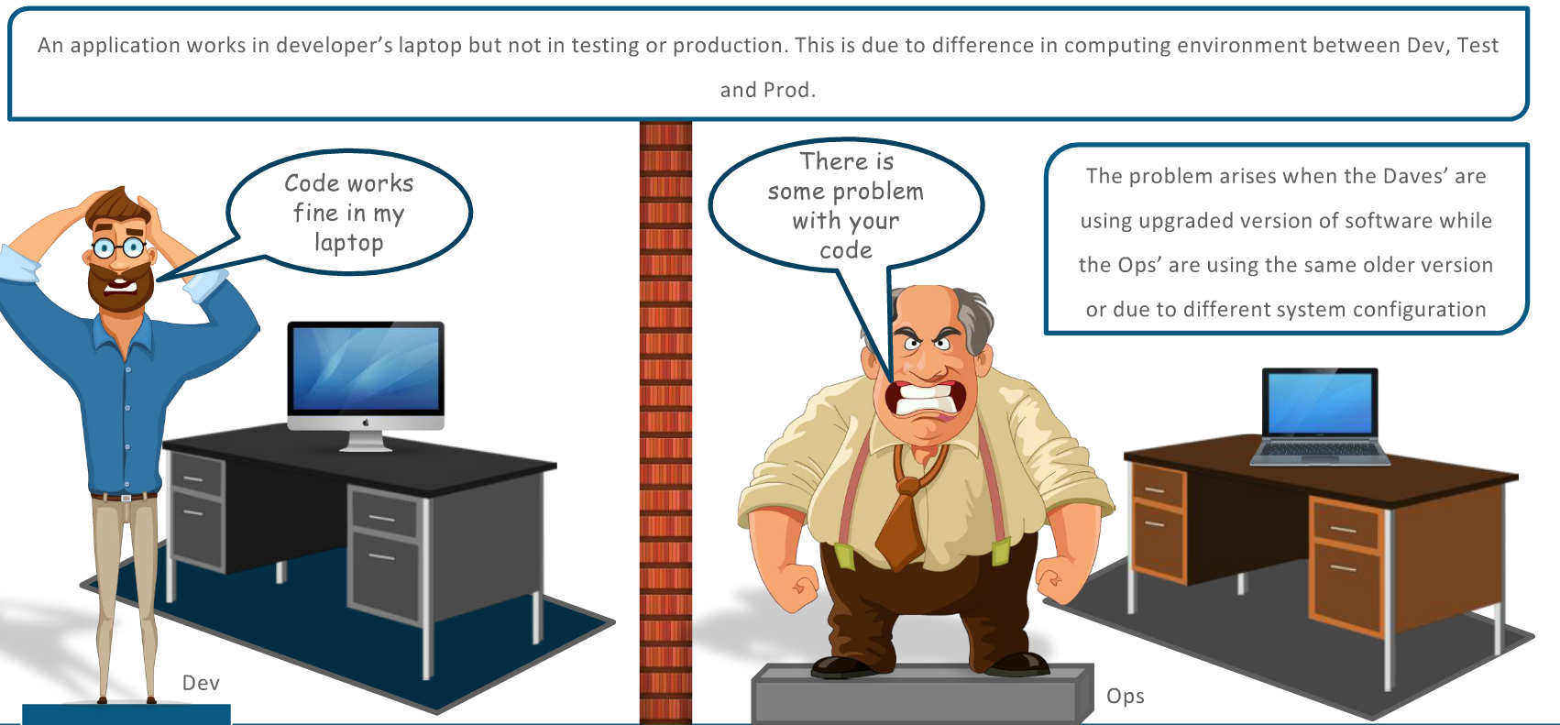

Slide 20

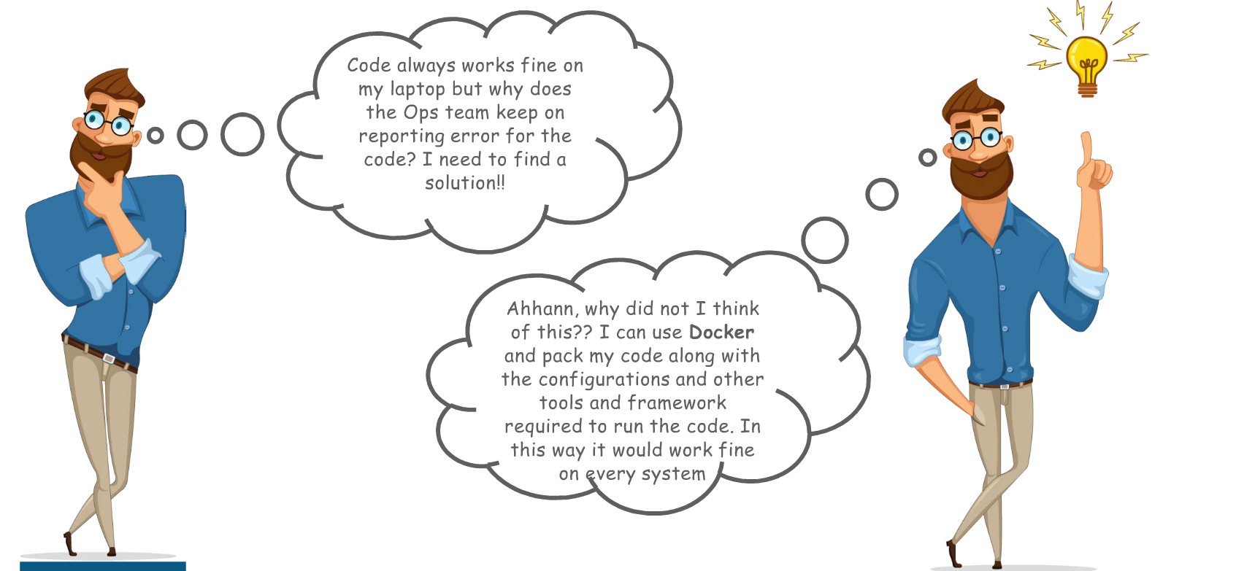

Slide 21
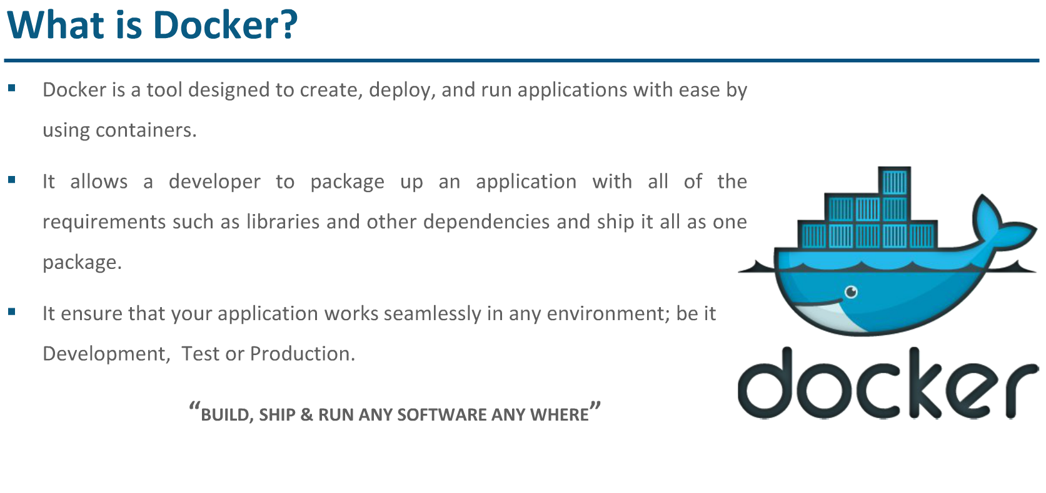

Slide 22

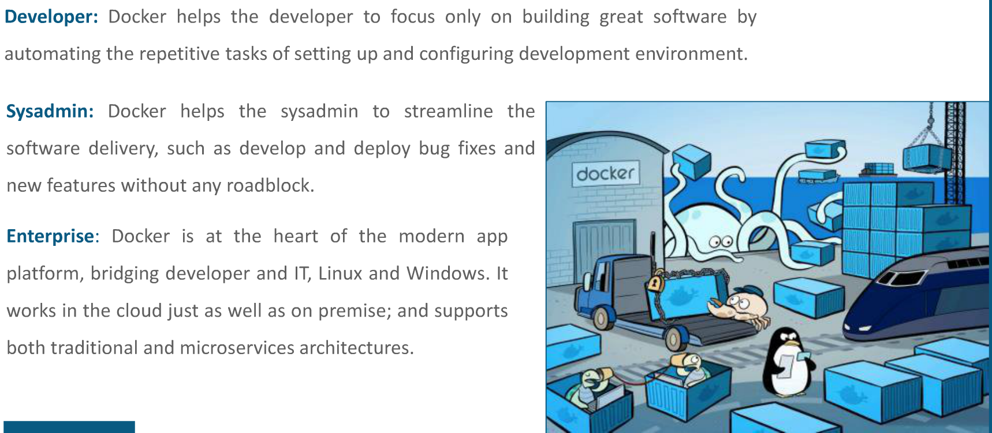

Slide 23

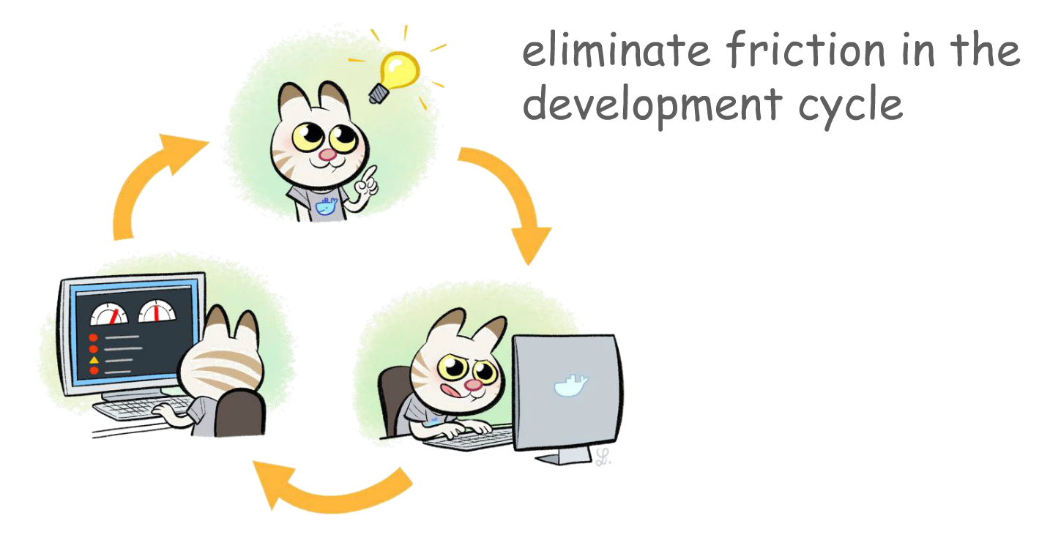

Slide 24

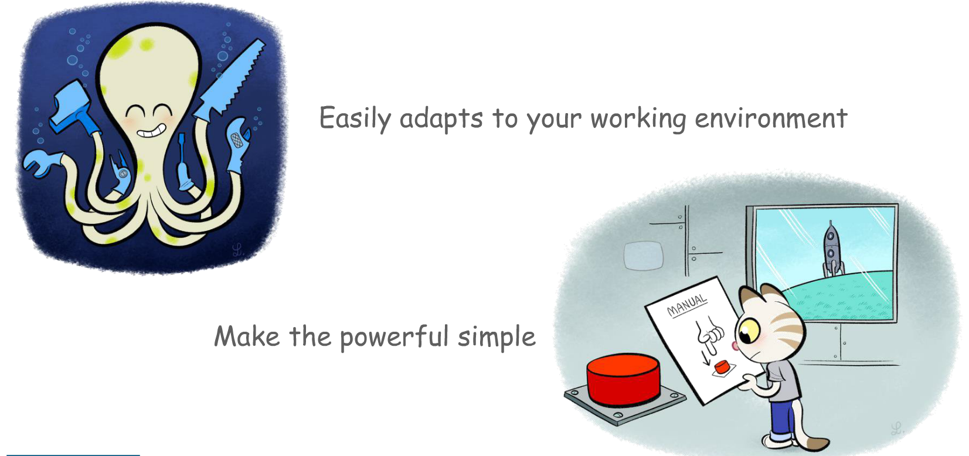

Slide 25
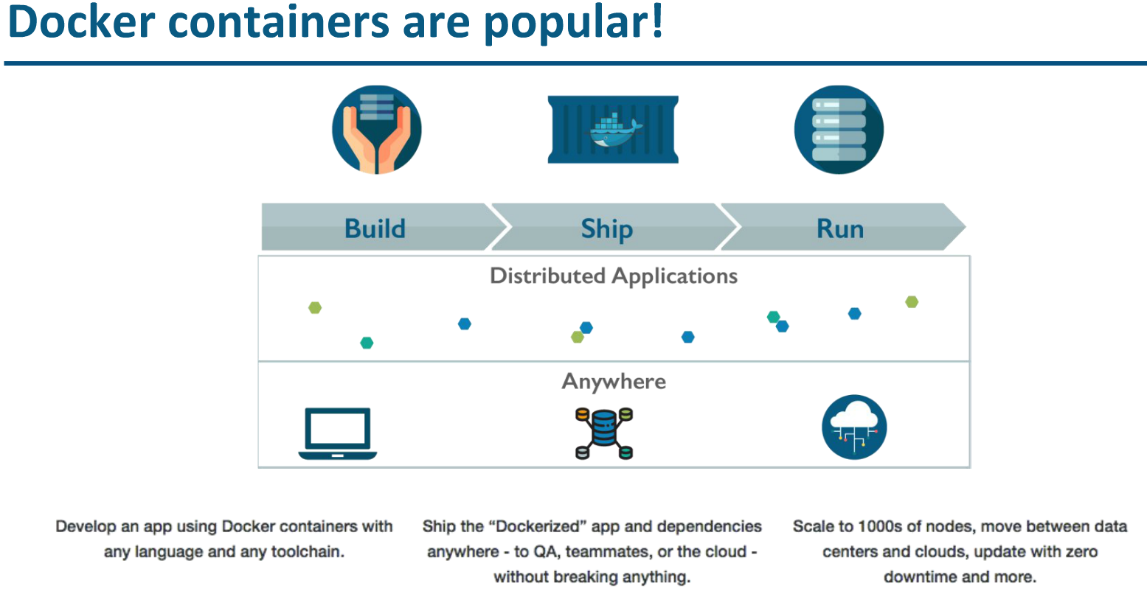

Slide 26
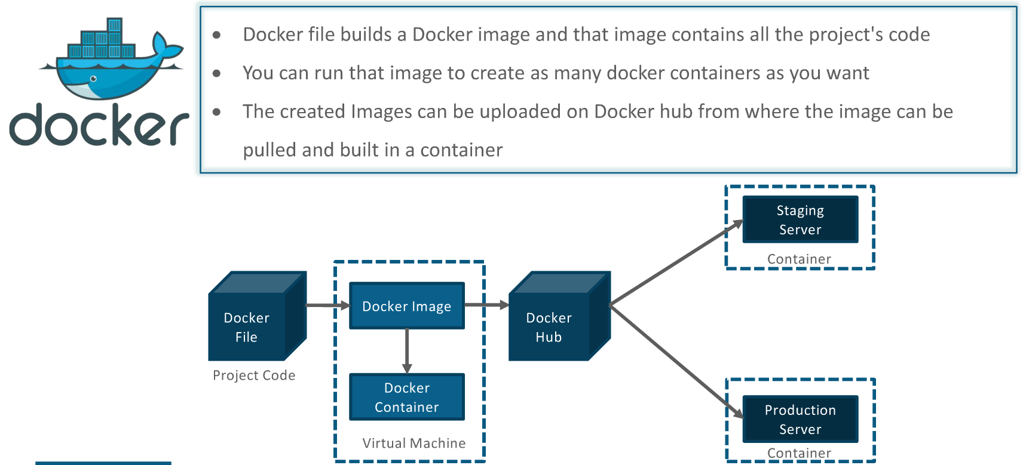

Slide 27
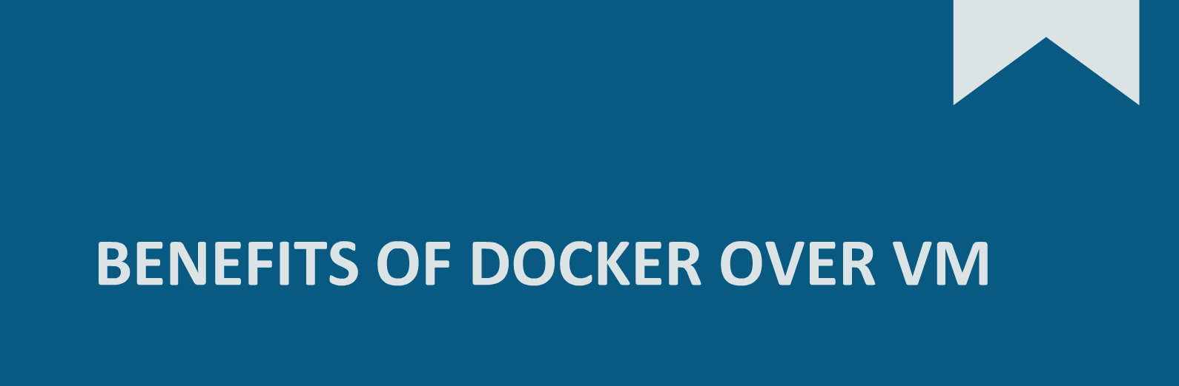

Slide 28
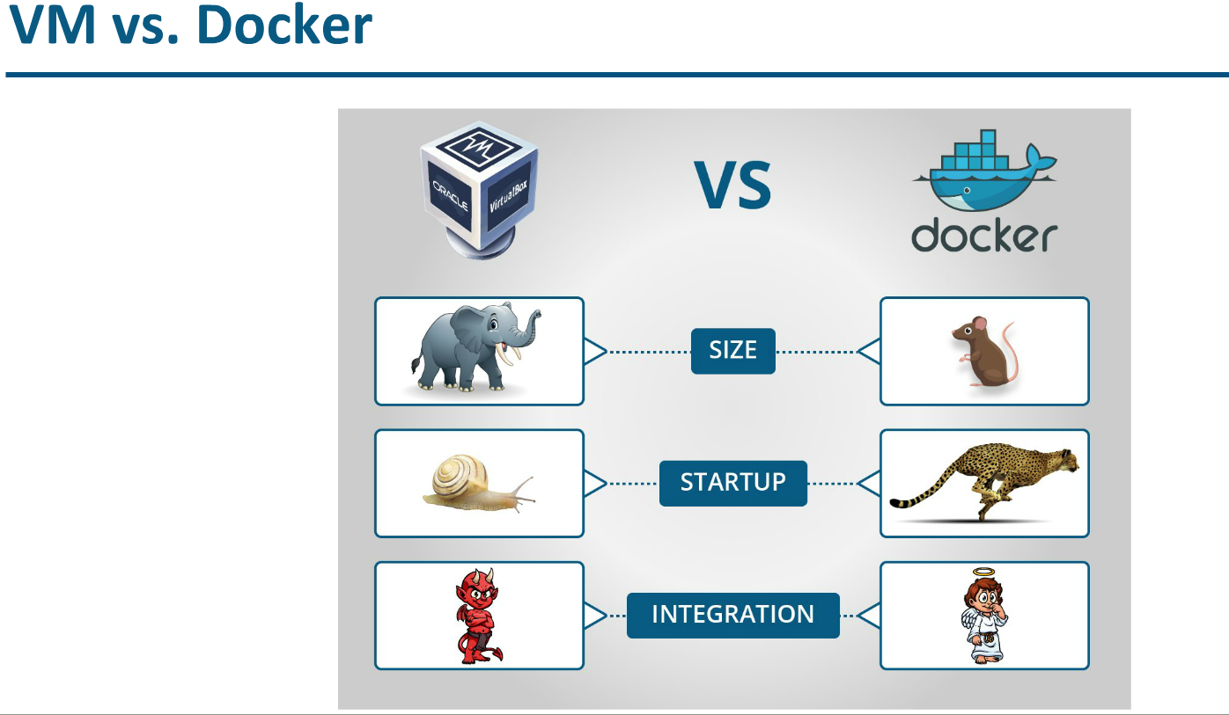

Slide 29
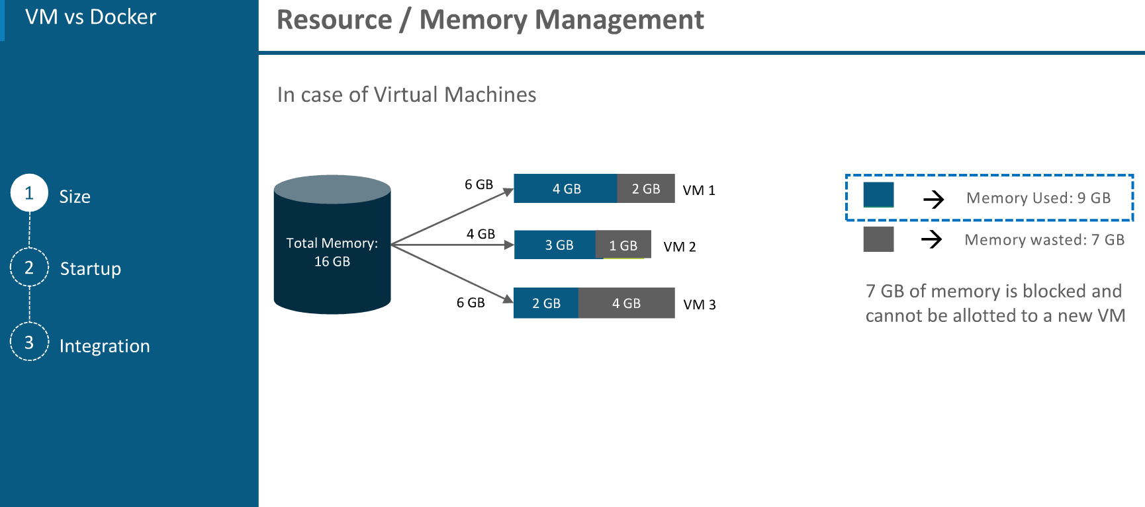

Slide 30
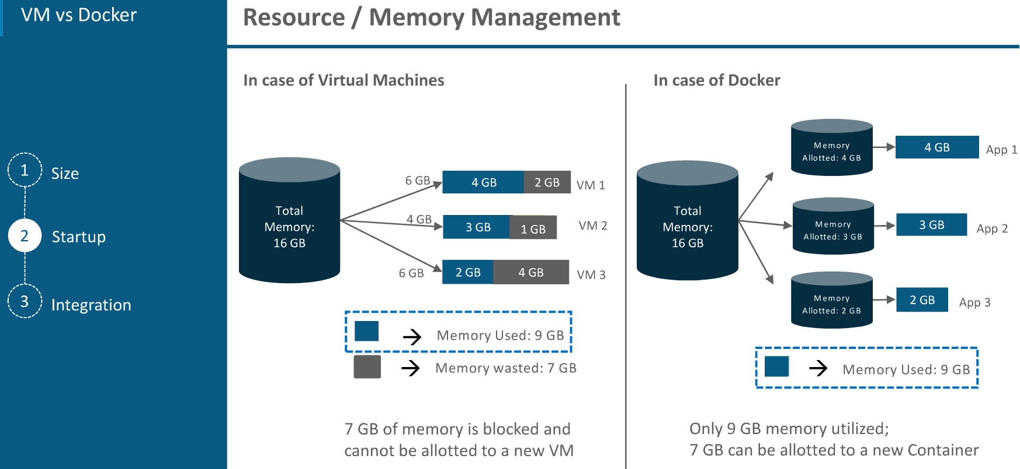

Slide 31
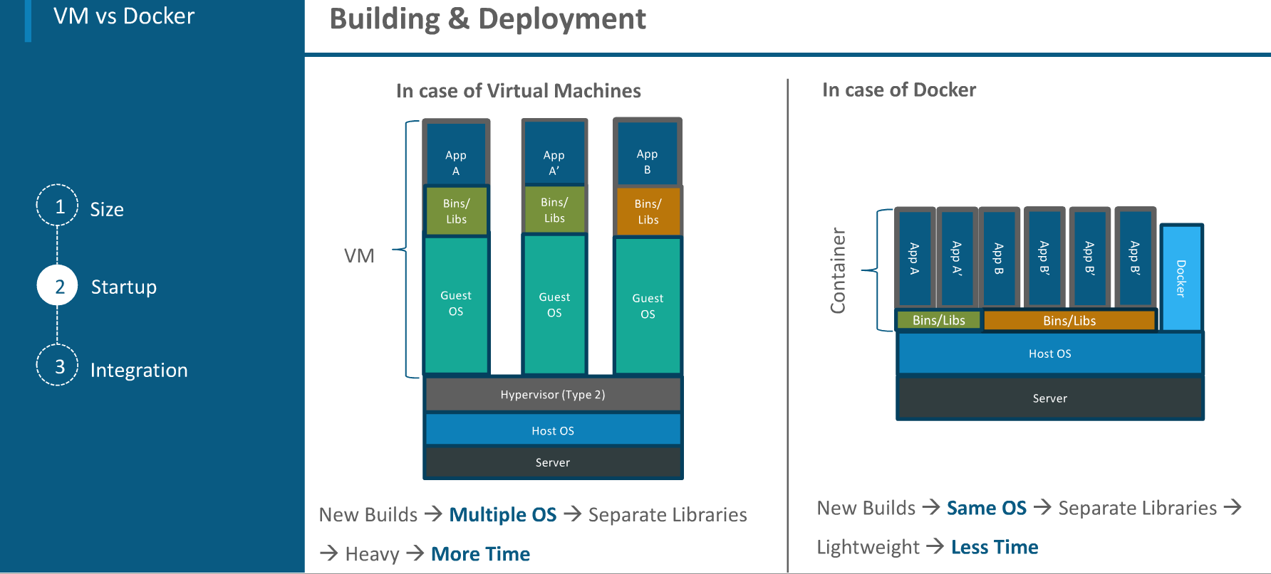

Slide 32
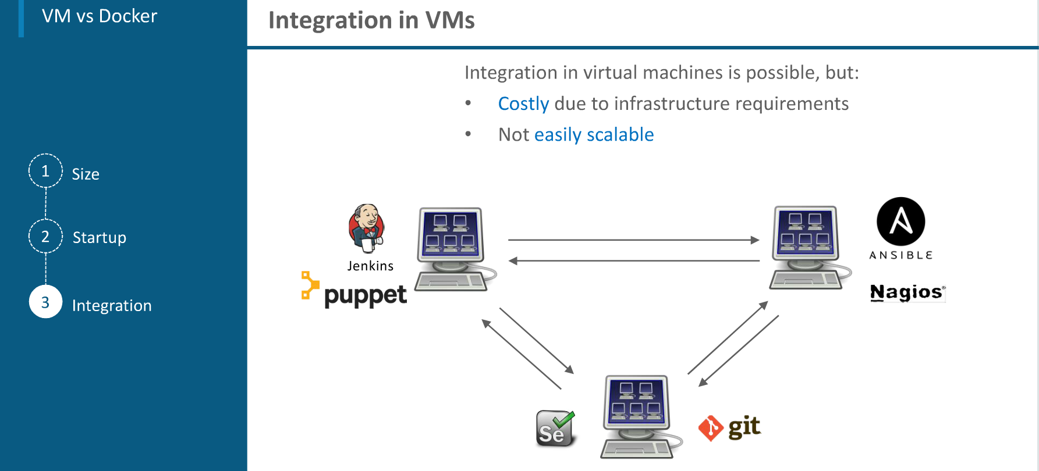

Slide 33
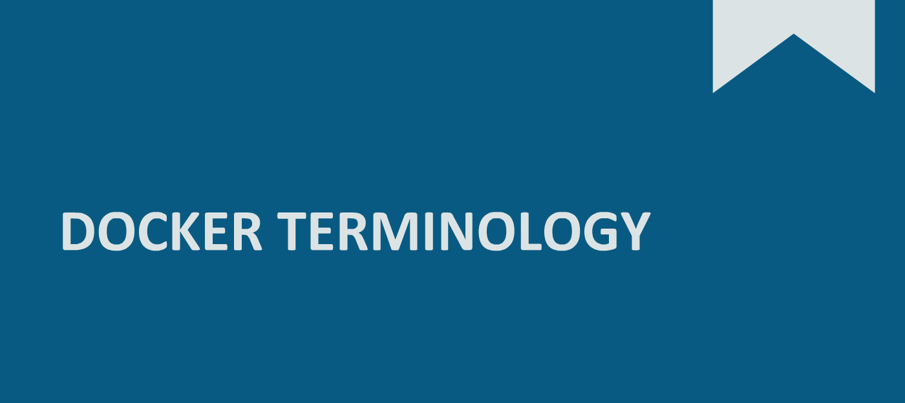

Slide 34
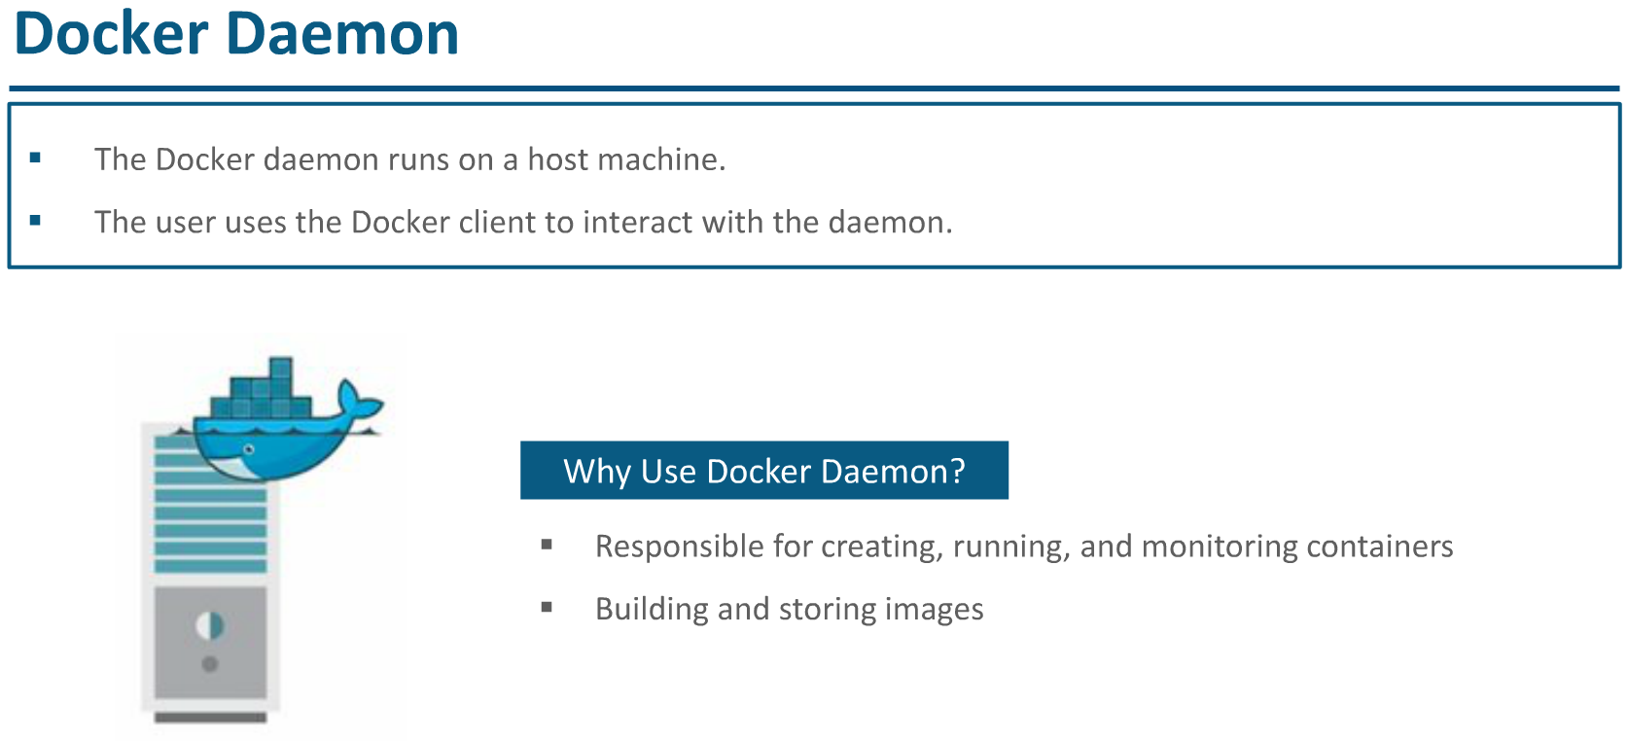

Slide 35
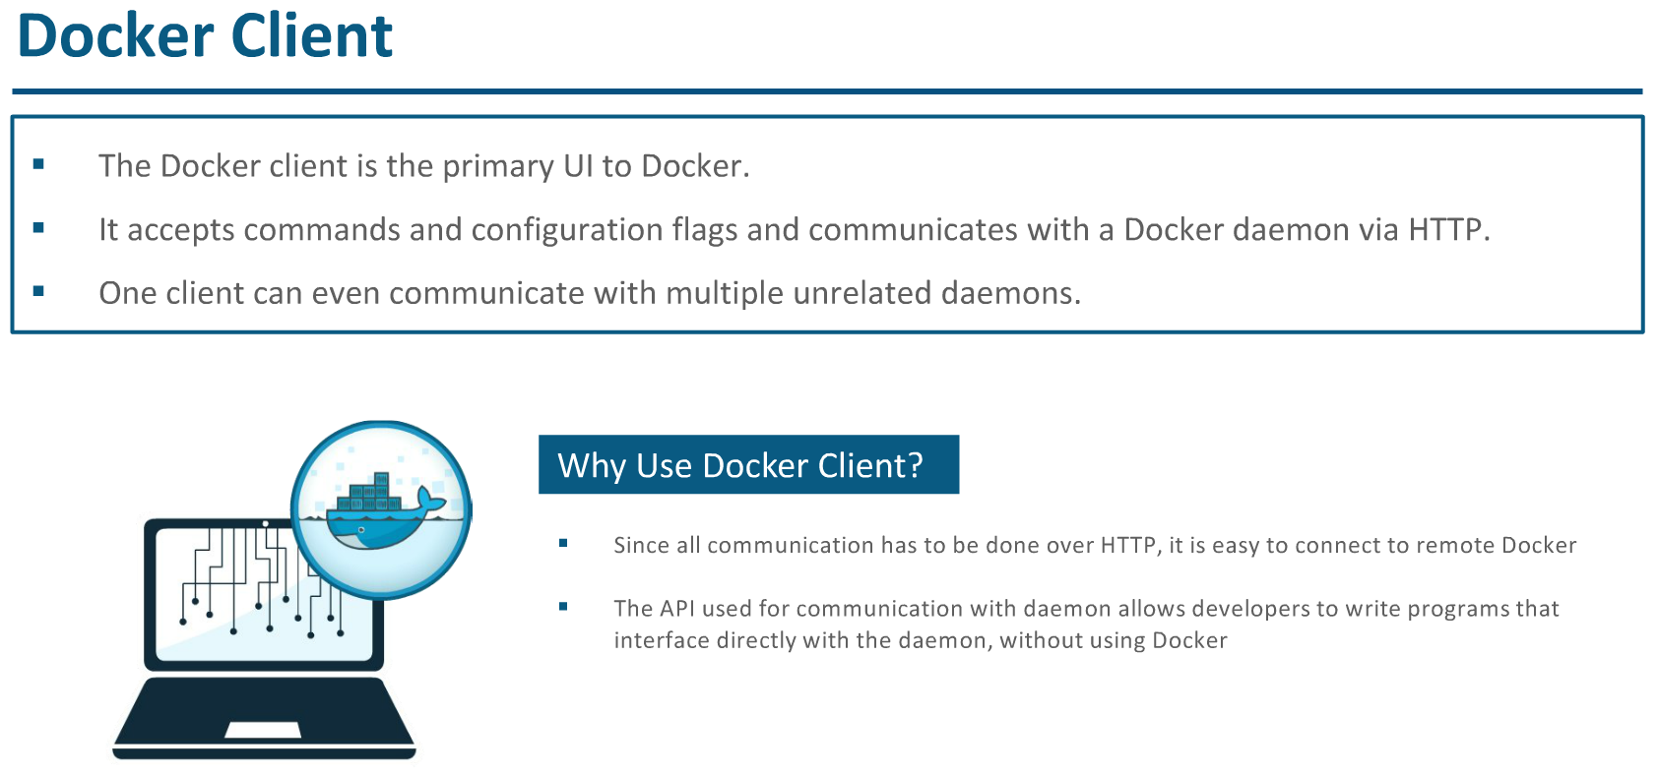

Slide 36
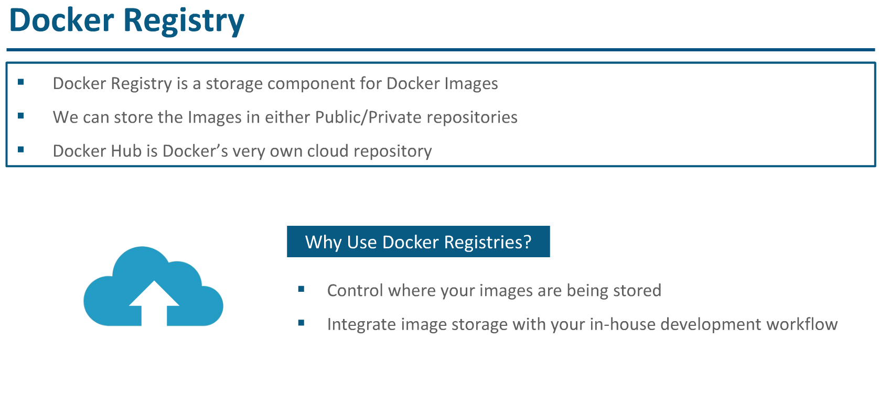

Slide 37
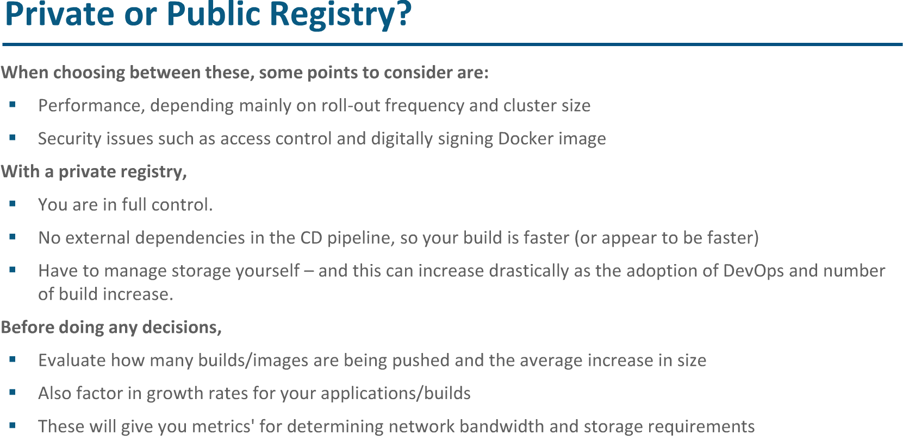

Slide 38
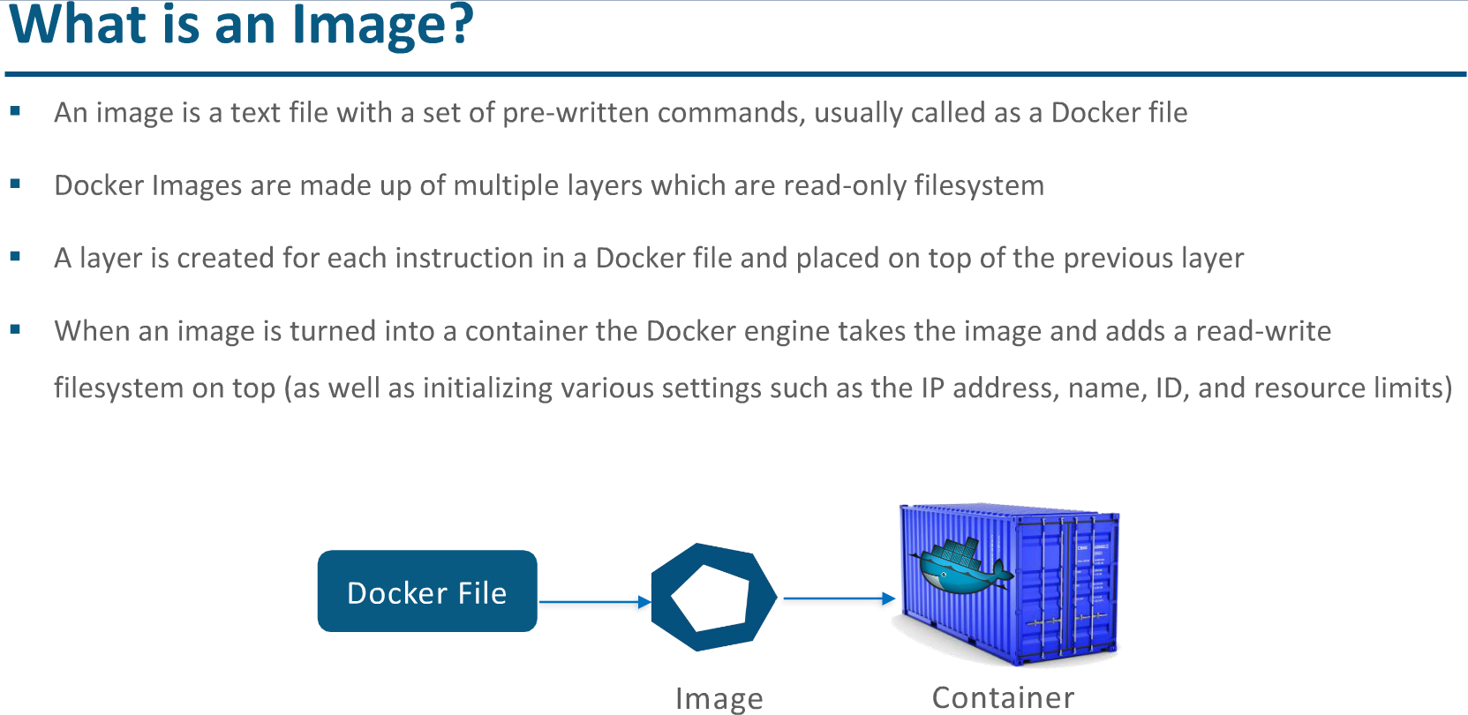

Slide 39
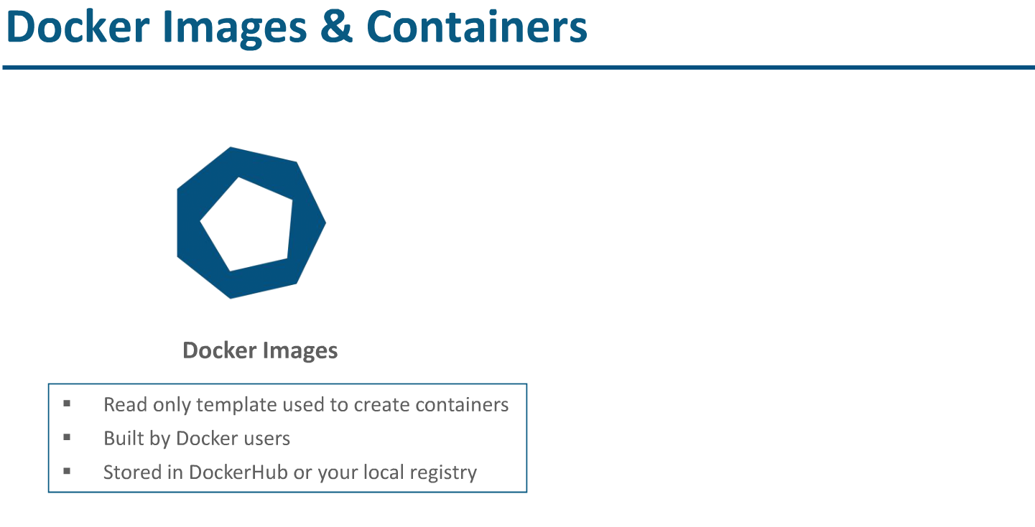

Slide 40
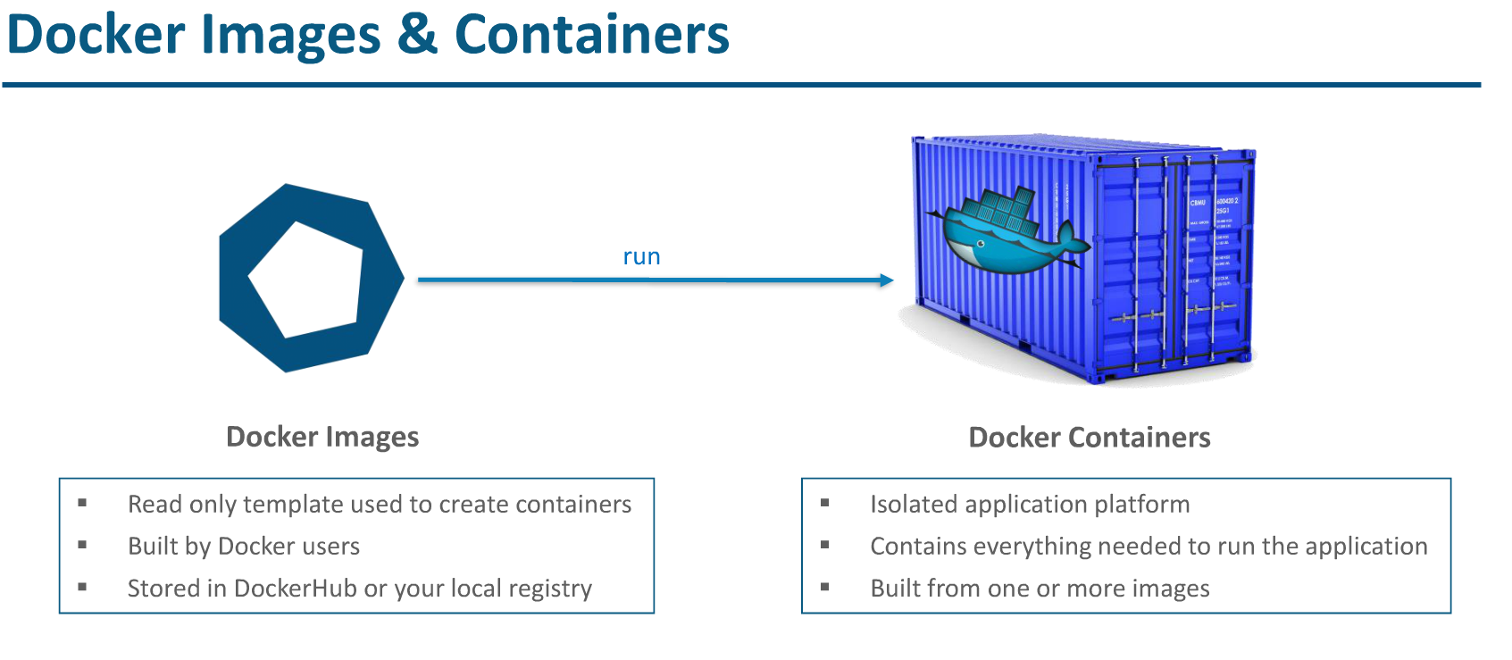

Slide 41
Container Orchestration Tools

Slide 42
Container Orchestration Tools
Container management refers to a set of practices that govern and maintain containerization software. Container management tools automate the creation, deployment, destruction and scaling of application or systems containers.
Tools available are
Docker Swarm
Kubernetes
Amazon ECS
Google cloud platform
Etc.…

Slide 43
Docker Swarm
Docker Swarm is an open-source container orchestration platform built and maintained by Docker. Under the hood, Docker Swarm converts multiple Docker instances into a single virtual host.
A Docker Swarm cluster generally contains three items:
Nodes
Services and tasks
Load balancers
Nodes are individual instances of the Docker engine that control your cluster and manage the containers used to run your services and tasks. Docker Swarm clusters also include load balancing to route requests across nodes.

Slide 44
Kubernetes
Kubernetes is an open source container orchestration platform that was initially designed by Google to manage their containers.
Kubernetes has a more complex cluster structure than Docker Swarm.
It usually has a builder and worker nodes architecture divided further into pods, namespaces, config maps, and so on.

Slide 45
Kubernetes Terminologies
Kubernetes cluster:
The K8s architecture is relatively simple. You never interact directly with the nodes hosting your application, but only with the control plane, which presents an API and is in charge of scheduling and replicating groups of containers named Pods. Kubectl is the command line interface that allows you to interact with the API to share the desired application state or gather detailed information on the infrastructure’s current state.

Slide 46
Kubernetes Terminologies
Nodes
Each node that hosts part of your distributed application does so by leveraging Docker or a similar container technology, such as Rocket from CoreOS. The nodes also run two additional pieces of software: kube-proxy, which gives access to your running app, and kubelet, which receives commands from the k8s control plane. Nodes can also run flannel, an etcd backed network fabric for containers.
Master
The control plane itself runs the API server (kube-apiserver), the scheduler (kube-scheduler), the controller manager (kube-controller-manager) and etcd, a highly available key-value store for shared configuration and service discovery implementing the Raft consensus Algorithm.

Slide 47
Difference between Docker swarm and Kubernetes
Docker Swarm is a lightweight, easy-to-use orchestration tool with limited offerings compared to Kubernetes.
In contrast, Kubernetes is complex but powerful and provides self-healing, auto-scaling capabilities out of the box

Slide 48
Ansible
Ansible is an open source automation and orchestration tool for software provisioning, configuration management, and software deployment. Ansible can easily run and configure Unix-like systems as well as Windows systems to provide infrastructure as code. It contains its own declarative programming language for system configuration and management.

Slide 49
Introduction to Maven
Introduction to Jenkins
Introduction to Git
Introduction to SonarQube
Introduction to Artifactory
Introduction to Tomcat

